Slide 1
Current Challenges with OpenStack Ironic, SR-IOV, and OVN
Bartosz Bezak, StackHPC
Michał Nasiadka, StackHPC

Slide 2
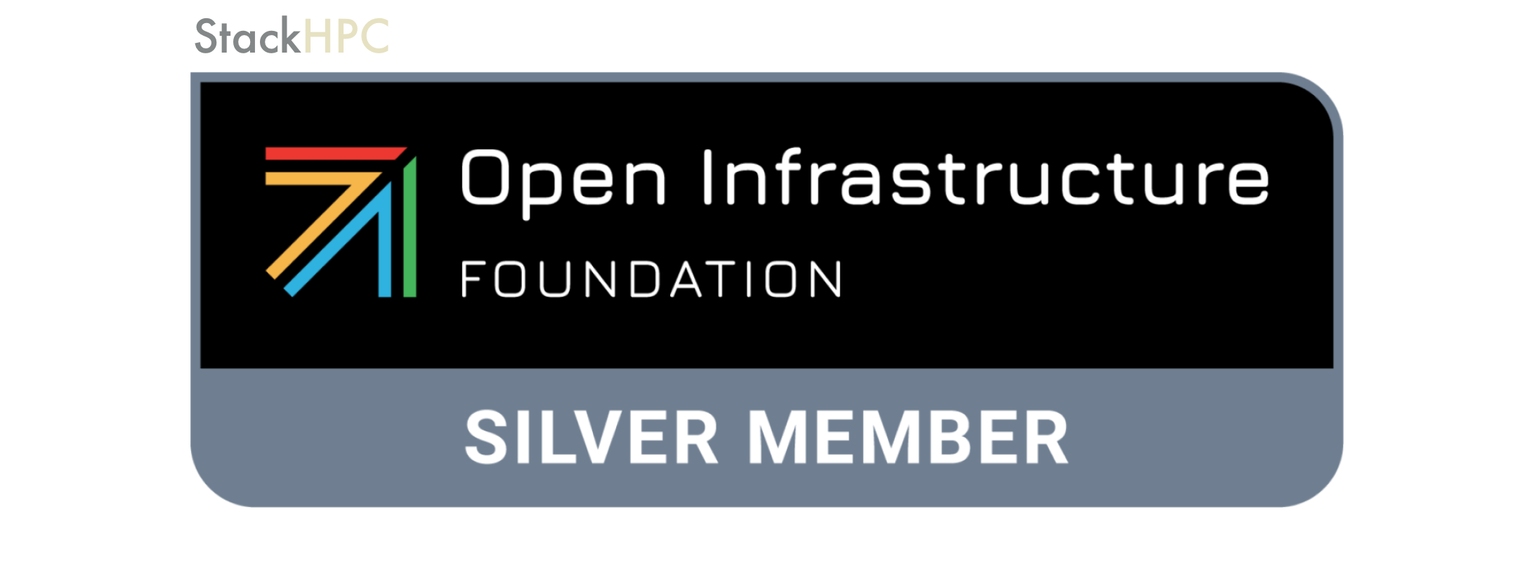
StackHPC Company Overview
Formed 2016, based in Bristol, UK
  Based in Bristol with presence in Oxford, Cambridge, France and Poland
  Currently around 30 people
Founded on HPC expertise
  Software Defined Networking
  Systems Integration
  Open Research Infrastructure Development and Operations
Motivation to transfer this expertise into Cloud to address HPC & HPDA (AI)
“Open” Modus Operandi
  Upstream development of OpenStack capability
  Consultancy/Support to end-user organizations in managing HPC service transition
  Scientific-SIG engagement for the Open Infrastructure Foundation
Hybrid Cloud Enablement

Slide 3
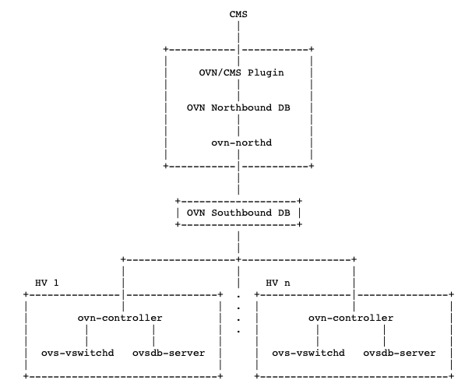
Architecture of OVN/OpenStack Integration
OVN Components:
Northbound DB: Stores logical network configurations.
Southbound DB: Holds physical runtime states.
Controller: Resides on hypervisors, manages flow tables on OVS instances.
Northd: Daemon translating high-level NB DB configurations into low-level SB DB.
OVN and OpenStack Interactions:
Neutron: Communicates with Northbound DB, driving logical network configurations.
ML2 Plugin: Facilitates this communication, acting as a bridge.

Slide 4
External Ports and Their Management in OVN
Purpose:
External logical ports in OVN are specialized ports that provide OVN native services to external entities.
Enable OVN services (e.g., DHCP, DNS, IPv6 RA) for resources that bypass the standard OVN networking stack, such as SR-IOV and baremetal deployments.
Management in OVN:
Configured through the OVN Northbound Database.
Utilizes Logical Switch Port with type external.
Managed via HA Chassis Groups to ensure high availability.
HA Chassis group needs to have ovn-bridge-mappings with L2 connectivity
Logical Switch has localnet port
Notes:
• These ports are crucial for scenarios where resources like SR-IOV-enabled VMs and baremetal servers require direct access to network hardware or bypass the virtual networking stack for performance reasons.
• In OVN these external ports by creating Logical_Switch_Port entries with type=external in the Northbound Database.
• High Availability is achieved through HA Chassis Groups, ensuring that services remain available even if one chassis fails.

Slide 5
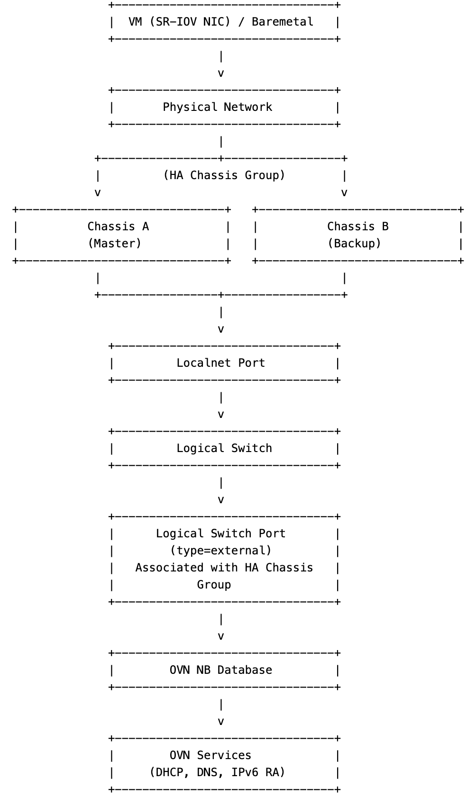
Notes:
• These ports are crucial for scenarios where resources like SR-IOV-enabled VMs and baremetal servers require direct access to network hardware or bypass the virtual networking stack for performance reasons.
• In OVN these external ports by creating Logical_Switch_Port entries with type=external in the Northbound Database.
• High Availability is achieved through HA Chassis Groups, ensuring that services remain available even if one chassis fails.

Slide 6
External Ports in Neutron: Baremetal and SR-IOV
Primary Use Cases:
SR-IOV Ports:
Enable high-performance networking by allowing VMs to bypass the kernel networking stack.
Baremetal Ports:
Facilitate direct hardware access for baremetal servers managed by OpenStack Ironic.
Neutron’s Role:
Creates external ports in OVN for specific vnic_types: direct, direct-physical, macvtap, baremetal.
Ensures OVN can provide necessary services without direct handling by local OVS instances.

Slide 7
Neutron’s Chassis Scheduling Mechanism
Chassis Scheduling:
Neutron schedules external ports onto gateway chassis.
Utilizes different scheduler plugins, such as OVNGatewayLeastLoadedScheduler, which ensures efficient scheduling in terms of load distribution for GW Chassis.
HA Chassis Group:
A new concept to manage multiple HA chassis (OVN will bind External port on highest priority chassis in this group to provide DHCP/DNS services) with defined priorities.
Ensures that external ports are bound to the master chassis based on priority.
Scheduling Strategy:
Ensures high availability and load balancing across chassis.
Master chassis handles the port; backups take over in case of failure.
Notes:
• Neutron employs various scheduler plugins to determine which chassis should host external ports.
• Previously, with a single gateway chassis, the scheduling was straightforward. However, in environments with multiple chassis, determining where to bind external ports became complex.
• The introduction of HA Chassis Groups addresses this by linking multiple gateway chassis with defined priorities. The master chassis handles the external ports, and if it fails, the next chassis in priority takes over.
• This scheduling strategy ensures that external ports are efficiently distributed across chassis, providing both high availability and balanced load distribution.

Slide 8
Challenges with Current Scheduling Methods
Performance/Functional Issues:
External ports and router gateway ports may be bound to different chassis.
Leads to lack of routing.
MAC Flapping:
Inconsistent HA group assignments can cause MAC address issues (HA chassis per Logical_Switch ensures no MAC flapping between physical switches).
Redundancy Management:
Current redundancy is managed separately by Neutron for gateway ports and external ports.
Notes:
• One of the main challenges arises when external ports and router gateway ports are scheduled on different chassis. This separation can cause inefficient routing of traffic, resulting in lack of routing
• Additionally, inconsistent assignments within HA Chassis Groups can lead to MAC flapping, where the same MAC address appears on multiple ports, causing network instability.
• Currently, redundancy for external ports is managed by OVN using HA Chassis Groups, while Neutron independently manages redundancy for router gateway ports. This separation can lead to mismatches and performance bottlenecks.

Slide 9
Possible Solution and Future Plans
Unified Scheduling Strategy:
Align scheduling strategies for both external and router gateway ports (so these are consistent).
Use HA Chassis Groups consistently across all port types.
New L3 Scheduler:
Introduction of OVNGatewayHAChassisGroup scheduler.
Utilizes HA Chassis Groups for gateway port scheduling, keeps GW Chassis and HA Chassis priorities in sync for routing functions.
Implementation Status:
Work in progress, however more testing needed (https://bugs.launchpad.net/neutron/+bug/1995078).
Benefits:
Improved performance by ensuring external and gateway ports are on the same chassis.
Enhanced high availability and load balancing.
Notes:
• To address the existing challenges, the plan is to unify the scheduling strategies for both external ports and router gateway ports. This involves consistently using HA Chassis Groups across all port types.
• A new L3 scheduler, OVNGatewayHAChassisGroup, is being implemented to ensure that gateway ports are scheduled using HA Chassis Groups, similar to external ports. This alignment will prevent performance issues caused by mismatched port bindings.
• This patch is currently under review
• The expected benefits include improved network performance, as external and gateway ports will reside on the same chassis, reducing traffic routing inefficiencies

Slide 10
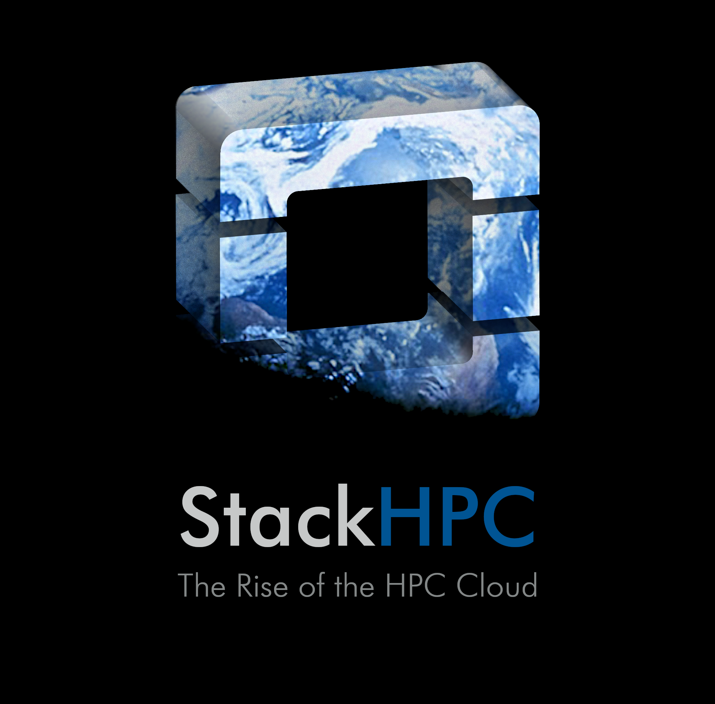
Thank You
https://www.stackhpc.com

